Slide 1
Troubleshooting
Tulika Chaudharie, Senior Escalation Engineer, EEE

Slide 2

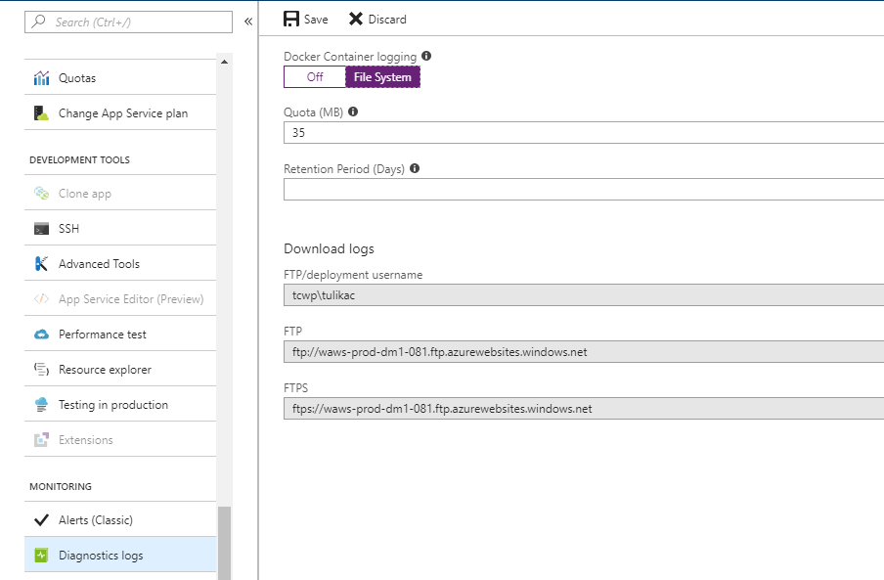
Docker Logs
Show output from Docker daemon and STDERR/STDOUT from container.
STDERR/STDOUT not enabled by default for custom images.
Enable STDERR/STDOUT using Docker Container Logging setting in portal.

Slide 3
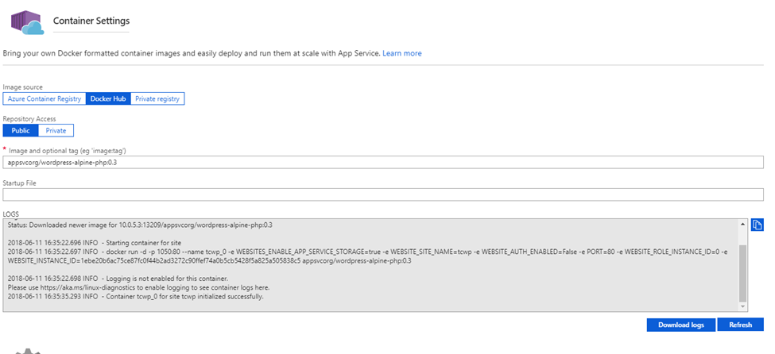
Viewing Docker Logs
Container Settings blade
FTP
Kudu API
Notes:
Point out that the Docker output here is truncated. Clicking Download Logs gets you full logs.
FTP to the website and the logs will be located in the /Logfiles directory. You can also access this via the Kudu (Advanced Tools) Bash console. The naming convention for the Docker log is YYYY_MM_DD_RDxxxxxxxxxxxx_docker.log
Use the Kudu API that allows you to easily see the current Docker log details (such as the filename, etc.) and download the current Docker logs in Zip format.
To see details on the current Docker logs in JSON format, you can use this URL:
https://[sitename].scm.azurewebsites.net/api/logs/docker
You can get to this easily by going to Advanced Tools (Kudu) and then appending "/api/logs/docker" to the URL. The output of this will be a JSON response with the most relevant and current Docker logs.
Point out that a JSON extension helps.
If you want to download the logs shown in the above API in Zip format, append "zip" to the URL. For example:
https://[sitename].scm.azurewebsites.net/api/logs/docker/zip

Slide 4
Docker Log Example - Logging Disabled
2018-06-15 12:23:43.487 INFO - Issuing docker pull: imagename =appsvcorg/wordpress-alpine-php:0.3
2018-06-15 12:23:44.406 INFO - docker pull returned STDOUT>> 0.3: Pulling from appsvcorg/wordpress-alpine-php
Digest: sha256:68a6f807771668f73d808a452f77462d1c8536cc1fb5776a9dcf404d1a673a1e
Status: Downloaded newer image for 10.0.5.2:13209/appsvcorg/wordpress-alpine-php:0.3
2018-06-15 12:23:44.529 INFO - Starting container for site
2018-06-15 12:23:44.529 INFO - docker run -d -p 11931:80 --name tcwp_0 -e WEBSITES_ENABLE_APP_SERVICE_STORAGE=true -e WEBSITE_SITE_NAME=tcwp -e WEBSITE_AUTH_ENABLED=False -e PORT=80 -e WEBSITE_ROLE_INSTANCE_ID=0 -e WEBSITE_INSTANCE_ID=1ebe20b6ac75ce87fc0f44b2ad3272c90ffef74a0b5cb5428f5a825a505838c5 appsvcorg/wordpress-alpine-php:0.3
2018-06-15 12:23:44.529 INFO - Logging is not enabled for this container.
Please use https://aka.ms/linux-diagnostics to enable logging to see container logs here.

Slide 5
Docker Log Example - Container Startup

Slide 6
Startup Issues
Container is successfully started when it starts AND when it responds to HTTP ping.
We wait for 230 seconds by default for startup.
You can increase this up to 1,800 seconds using the WEBSITES_CONTAINER_START_TIME_LIMIT app setting.
If you don’t expose a port in your Dockerfile, you can do so with the WEBSITES_PORT app setting.

Slide 7
Using Observer
You can verify the OS is Linux by checking the is_linux property of the ServerFarm.
You can determine Docker configuration using the linux_fx_version property of the site.
If this property starts with “DOCKER”, the app is a Web App for Containers app.
If this property is a long, Base64-encoded string, it’s a multi-container deployment.
Otherwise, the app is App Service on Linux and this property will show the blessed image.
You can find the tenant ID (for Kusto queries) via the stamp_deployment_id property on the WebWorker tab.
Notes:
Recommend that you walk through what this looks like at this point.
You also may want to show the decoding of a multi-container setup here.

Slide 8
Kusto Tables
Table name | Description
LinuxRoleInstanceHeartBeats | As the name suggests, this is a HeartBeat table which has an entry every 5 mins for every instance
AntaresIISLogFrontEndTable | IIS requests which reached the Frontend. The Frontend for Linux and Windows stamps are the same
WorkerApacheAccessLogEventTable | This table logs the requests that came to the nginx server. It is very similar in structure to the AntaresIISLogWorkerTable
WorkerApacheErrorsEventTable | This is an error log for nginx. It is useful for debugging cold starts and request timeouts
WorkerSystemStats | This table logs the output of the following commands run on the instance every 5 mins df top iotop iostat ps docker_ps cpu_idle cpu_user cpu_system

Slide 9
Kusto Tables (continued)
Table Name | Description
LinuxRuntimeEvents | This table has various information regarding site container start/stop/recycle, including reasons why the container gets recycled (e.g. storage volume failover). This table also has LWAS restart events.
LinuxSiteStats | This table contains CPU and memory percentage per site per instance. We can use this table for knowing worker instance allocations as well.
WorkerSyslogEventTable | This table is logging basic Linux system information. It also logs docker daemon events
DefaultLogEventTable | It contains Linux kern.log. It includes information about RolePatcher, MSDS, Authpriv, Cron, etc
WorkerAzureAgentEventTable | Guest agent logs
WorkerOnStartEventTable | Outputs boot start phase on onstart

Slide 10
Troubleshooting with Kusto - Step One
Check the AntaresIISLogFrontEndTable to find the IP address of the worker.
Query the LinuxRoleInstanceHeartBeats table using the IP address to find the RoleInstance and Tenant.
Notes:
Recommend that you do a walkthrough on Kusto showing these queries on a live site.

Slide 11
Troubleshooting with Kusto - Step Two
Query the WorkerApacheAccessLogEventTable to see if Nginx routed the request to a worker.
Notes:
Recommend that you use Kusto to see real data on this.

Slide 12
Troubleshooting with Kusto - Step Three
Use the WorkerLWASEventTable to see LWAS events.
Be careful! This is a verbose table and many entries that may appear to be problems aren’t.
Notes:
Recommend you wait until the next slide before you demo.

Slide 13
LWAS Events
Web App starting:
Will also show image being pulled.
Will show the container being created.
Will show the Docker pull
Will show StartContainerUnit successful upon successful start.
Notes:
Now I recommend that you do a demo of this.

Slide 14
Red Herrings
Some exceptions that are logged to the LWAS table are red herrings.
Don’t assume an exception is a problem unless you are familiar with it and you KNOW it’s a problem.
Many exceptions are like first-chance exceptions; they’re normal!
This exception can be ignored. It’s simply a result of the Docker daemon searching for the image on the local disk cache.

Slide 15
Identifying Storage Failover
Storage failovers will only impact a Linux customer if WEBSITES_ENABLE_APP_SERVICE_STORAGE is True.
Storage failover will cause a non-overlapped recycle.
Linux customers are more impacted because of long startup time for containers.

Slide 16
Example of Storage Failover

Slide 17
Troubleshooting App Restarts
Restart information is logged in WorkerLWASEventTable.

Slide 18
Another Way - LinuxRuntimeEvents
Notes:
Make sure you point out “OverlappedWithDifferentConfig”. This is an overlapped recycle and will not result in failed requests.

Slide 19
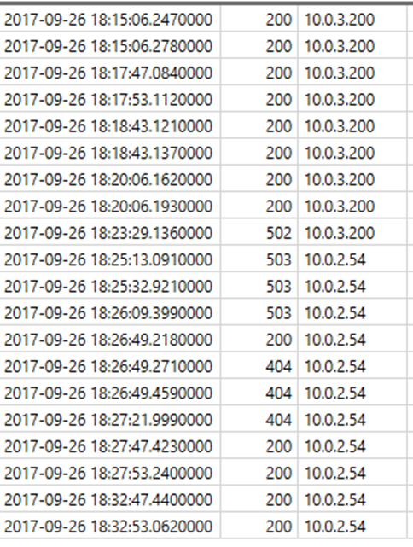
Identifying Instance Changes
There is an Instance Allocations Event in App Lens, but it won’t show if an app shifted to a new instance.
Best way right now is to check the AntaresIISLogFrontEndTable and look for a change in ServerRouted.

Slide 20
Why an instance change?
Use TimeSinceLastReboot and BuildVersion in LinuxRoleInstanceHeartbeats to determine if this was an infrastructure upgrade.
Check Msg column in WorkerAzureAgentEventTable for more information.

Slide 21
Checking CPU and Memory
LinuxSiteStats shows CPU and memory per container.

Slide 22
Process Detail on CPU and Memory
Use the WorkerSystemStats table to find process info on resource usage.

